Slide 1
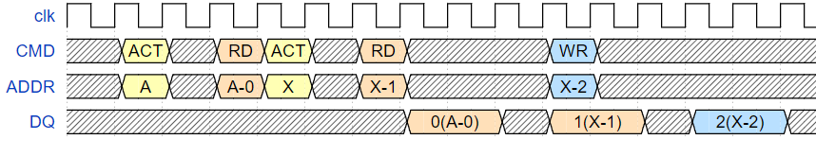
DDR2 Parameter
Q. Please refer to the provided DDR2 Parameter and draw the Timing Diagram (CMD, Addr, DQ) for accessing the DRAM in the order of the table below, ensuring the least amount of time is consumed. (Open page policy)
Objective: Understand the bandwidth difference depending on the row hit/miss in a bank under the Open page policy.
Condition 1: Assume that there are only three DRAM CMDs: ACT, READ/write, and PRE.
Condition 2: The order of data access must be sequential. The data coming out from DQ should be in the order of idx!
Condition 3: It is assumed that the memory controller knows all the upcoming DRAM access patterns.
DDR2 Timing Constraints (unit: cycle)
Start
CL | 3
AL | 1
RL | 4 (CL+AL)
WL | 3 (RL-1)
BL | 4
tRAS | 10
tRCD | 3
tRRD | 3
tRC | 13
tRP | 3
tCCD | 2
tRTP | 2
tWTR | 2
tWR | 3
tRTRS | 1
tCWD | 2
tRTW | 4
idx | R/W | Bank | Row | Col
0 | R | 0 | A | 0
1 | R | 1 | X | 1
2 | W | 1 | X | 2
3 | R | 0 | A | 3
4 | R | 1 | X | 4
5 | R | 1 | X | 1
6 | R | 0 | B | 3
7 | R | 0 | A | 2
8 | W | 1 | Y | 3
9 | W | 1 | Y | 4
10 | W | 0 | A | 2
11 | R | 0 | A | 3
12 | R | 1 | X | 0
13 | R | 1 | Y | 1
14 | W | 1 | X | 2
Timing Diagram Example
End
DRAM Access Table

Slide 2
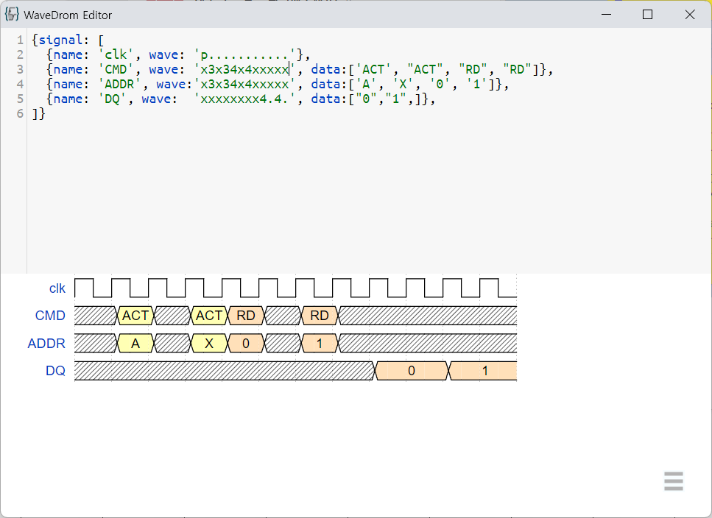
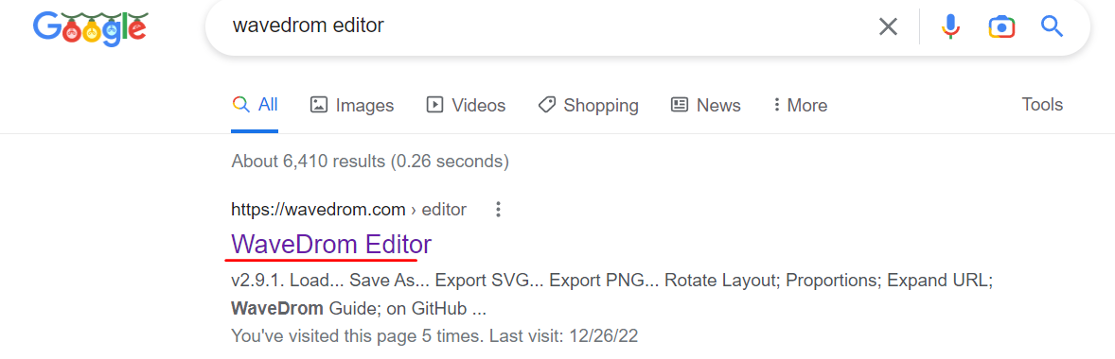
Submission
Upload ‘WaveDrom (editor)’ code files
E-mail : ???
Due date : ???

